Slide 1

10
Terraform Architecture
Notes:
Hello and welcome to my youtube channel, My name is Gurpreet
In this video series, I am gonna talk about Automate GCP with Terraform
I will be happy to share my knowledge and experience related to Terraform with examples and demos in this video series

Slide 2
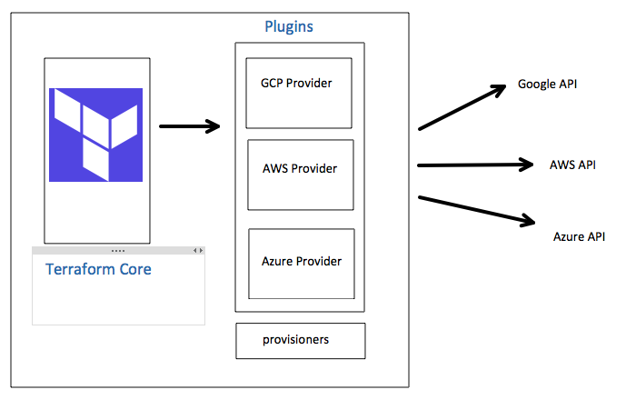
Terraform Architecture
Terraform architecture consist of following
Terraform Core
Provider Plugins
Provisioners
Notes:
Open source mean ; Community driven
No need to be a coder, no need to change carrier to become programmer
Cloud formation can only used in AWS, deployment only used in GCP etc
Next slide, lets discuss about current IT legacy process and deployment models

Slide 3
09
Terraform Resources
Notes:
Hello and welcome to my youtube channel, My name is Gurpreet
In this video series, I am gonna talk about Automate GCP with Terraform
I will be happy to share my knowledge and experience related to Terraform with examples and demos in this video series

Slide 4
What is Terraform resource ?
Terraform resource block implements infrastructure objects
Objects
VM Machines
Network
Firewall
Load balancers etc….
It is very important part of the configuration in Terraform
Notes:
Open source mean ; Community driven
No need to be a coder, no need to change carrier to become programmer
Cloud formation can only used in AWS, deployment only used in GCP etc
Next slide, lets discuss about current IT legacy process and deployment models

Slide 5
Syntax / Arguments
Resource block contains block_type, block_name and arguments
block_type
Depends on the provider AWS/ GCP
Type of resource such as compute, firewall, network, database etc
Block_name
Its scope is local
Must be unique in the module
Arguments
Every block contain a arguments (required)
Arguments are provided under { } brackets
Notes:
Open source mean ; Community driven
No need to be a coder, no need to change carrier to become programmer
Cloud formation can only used in AWS, deployment only used in GCP etc
Next slide, lets discuss about current IT legacy process and deployment models

Slide 6
Meta Arguments
There are two kinds of arguments in block Regular and Meta arguments
Regular
Depends on the provider AWS/ GCP
Meta arguments
Provider
Count
Depends_on
For_each
Lifecycle
provisioner
Every block contain a arguments (required)
Arguments are provided under { } brackets
Notes:
Open source mean ; Community driven
No need to be a coder, no need to change carrier to become programmer
Cloud formation can only used in AWS, deployment only used in GCP etc
Next slide, lets discuss about current IT legacy process and deployment models

Slide 7
08
Terraform tfstate file
Notes:
Hello and welcome to my youtube channel, My name is Gurpreet
In this video series, I am gonna talk about Automate GCP with Terraform
I will be happy to share my knowledge and experience related to Terraform with examples and demos in this video series

Slide 8
What is Tfstate file ?
Terraform is an Infrastructure provisioning tool :
Terraform state file == read world infrastructure in JSON
It provide automation and backbone of Terraform product
Terraform uses state file to compare the desired state
State file and backup file are created automatically on local disk
Terraform file stored in root module
Without tfstate file, terraform would recreate the infrastructure again!
Notes:
Open source mean ; Community driven
No need to be a coder, no need to change carrier to become programmer
Cloud formation can only used in AWS, deployment only used in GCP etc
Next slide, lets discuss about current IT legacy process and deployment models

Slide 9
01
Introduction to Terraform, DevOps and IaaS
Notes:
Hello and welcome to my youtube channel, My name is Gurpreet
In this video series, I am gonna talk about Automate GCP with Terraform
I will be happy to share my knowledge and experience related to Terraform with examples and demos in this video series

Slide 10
Introduction to Terraform, DevOps and IaaS
Notes:
This video will be related to introduction to various terms and terminologies we used now days
If you are new or dont know about Terraform, devOps and IaaS, than this will be good video for you

Slide 11
Topics to Discuss
01
04
02
03
What is Terraform ?
Cloud agnostic IaaS code
Demo
Before IaaS
Will see Terraform in action
Legacy process
Benefits of Terraform
Features and usage of Terraform
Notes:
Lets jump into this and talk about
What we going to discuss in this video
Initially we start with basic of Terraform
What are the process and deployment models we use in legacy environment, this will be a fun topic to be discussed
Than going forward we will see Benefits of using terraform
IN the end we are going to see the demo

Slide 12
01
What is Terraform?
Provisioning Tool

Slide 13
What is Terraform ?
Terraform is an Infrastructure provisioning tool :
Its Open Source
It is human readable and machine editable. No need to be a Programmer or learn coding
It Uses Hashicorp Configuration Language (HCL)
Cool factors
Platform agnostic, provision in any infrastructure provider
One code syntax, One workflow … any Cloud Provider
Notes:
Open source mean ; Community driven
No need to be a coder, no need to change carrier to become programmer
Cloud formation can only used in AWS, deployment only used in GCP etc
Next slide, lets discuss about current IT legacy process and deployment models

Slide 14
What is Terraform ?
Terraform is an Infrastructure provisioning tool :
Its Open Source
It is human readable and machine editable. No need to be a Programmer or learn coding
It Uses Hashicorp Configuration Language (HCL)
Cool factors
Platform agnostic, provision in any infrastructure provider
One code syntax, One workflow … any Cloud Provider
Notes:
Open source mean ; Community driven
No need to be a coder, no need to change carrier to become programmer
Cloud formation can only used in AWS, deployment only used in GCP etc
Next slide, lets discuss about current IT legacy process and deployment models

Slide 15
02
Before IaaS
Before Infrastructure as Code

Slide 16
Before IaaS Code
On-premise
Manual
Ticket driven
Vertically scaled
Prone to mistakes and potential outages
Notes:
Need to create nlyte tickets- RBC example
Done manually, open a ticket
Need to scale a host vertically
Based on the demands and need are increasing so cloud is here to help
Iaas enable users to create, provision, update and manage every aspect of their infrastructure using HCL

Slide 17
IaaS as Code
It enable users to manage infrastructure as code
Users can create, update and manage
Provide infrastructure deployment consistency
Notes:
Provision Iaas
Create update delete deployments
Consistency

Slide 18
Wait! Ad hoc scripts
Ad hoc scripts tends to break, for example Ansible configuration management is different than Terraform
Notes:
User must be thinking what is the change
For example if they are already using the Ansible, Puppet, Chef in their infrastructure environment
Provisioning is different than configuration managments
Automation is bad

Slide 19
IaaS comes in many flavors
Every Cloud Provider has its own tool for IaaS
Infrastructure provisioning tool
Terraform
CloudFormation
AzureResourceManager
Deployment Manager
Notes:
Open source mean ; Community driven
No need to be a coder, no need to change carrier to become programmer
Cloud formation can only used in AWS, deployment only used in GCP etc

Slide 20
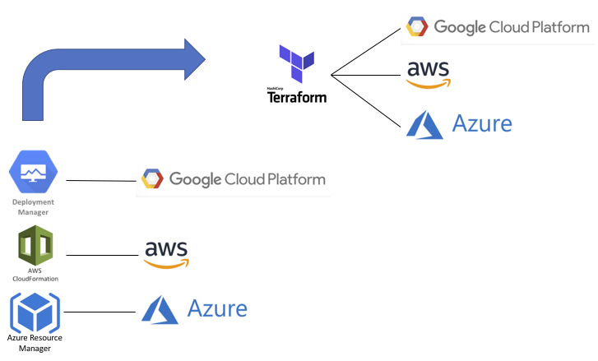
Terraform vs Other Provisioning tools

Slide 21
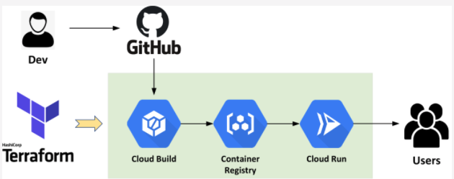
DevOps Pipeline with Terraform
Provision Services on Google Cloud

Slide 22
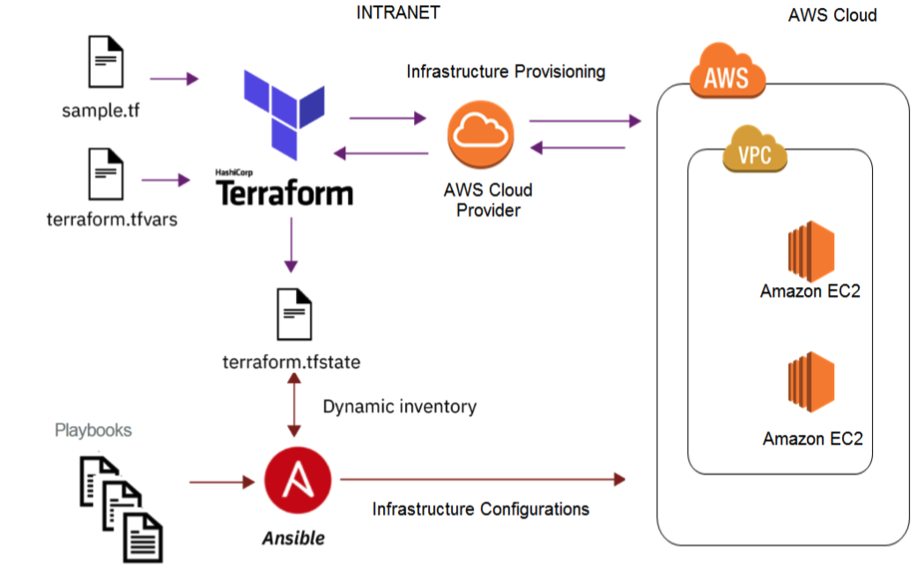
Provisioning with Terraform and Ansible on AWS
Terraform with Ansible

Slide 23
03
Benefits of Terraform
Features and usage of Terraform

Slide 24
Benefits of using IaaS for provisioning
No more IT tickets
Self serve
It is safe and can be validated
Infrastructure deployment consistency
Easier to upgrade or roll back

Slide 25
Benefits of using IaaS for provisioning
Terraform is declarative
We define desired state of the resource
Terraform is Idempotent
Terraform is Immutable
Will discuss above points in details during demo...
Notes:
Save us lot of headache
No need of domain knowledge
Traditional infrastructure no sort of auto scaling concepts
Cloud is different - add more resource of same type
- Idempotent compares the real world desired end state to decide what to add, delete or upgrade without having to
Reprovision the whole infrastructure
- immutable
Reduce configuration drift/bad changes
Easier to updgaer / rolls back

Slide 26
Use Cases
Provision IaaS Services
VMs, Virtual networks, Security groups, firewall, Containers or Kubernetes clusters.
Hub and Spoke security architecture.
Multi Cloud
App hosting service like Heroku
Disaster recovery sites or Test QA like Blue/Green deployments

Slide 27
—We will discuss in detail later
DEMO Time!

Slide 28
Terraform Documentation
Terraform CLI
Most important is command CLI, we going to use CLI to write scripts for terraform
Notes:
Code Terraform CLI
Glossary

Slide 29

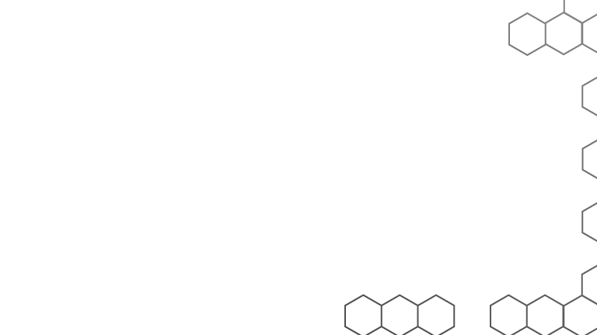
Subscribe for more content

Slide 30
02
Installation of Terraform, Linux, MacOS and Windows

Slide 31
Topics to Discuss
01
02
03
Ubuntu Installation
MacOS Installation
Windows Installation
Notes:
Lets jump into this and talk about
What we going to discuss in this video
Initially we start with basic of Terraform
What are the process and deployment models we use in legacy environment, this will be a fun topic to be discussed
Than going forward we will see Benefits of using terraform
IN the end we are going to see the demo

Slide 32
Instructions for Linux & MacOS
find the appropriate package for your system
After downloading Terraform, unzip the package
make sure that the terraform binary is available on your PATH.
Commands
sudo apt-get install unzip
wget https://releases.hashicorp.com/terraform/0.11.10/terraform_0.11.10_linux_amd64.zip
unzip terraform_0.11.10_linux_amd64.zip
sudo mv terraform /usr/local/bin/
terraform --version
Notes:
Save us lot of headache
No need of domain knowledge
Traditional infrastructure no sort of auto scaling concepts
Cloud is different - add more resource of same type
- Idempotent compares the real world desired end state to decide what to add, delete or upgrade without having to
Reprovision the whole infrastructure
- immutable
Reduce configuration drift/bad changes
Easier to updgaer / rolls back

Slide 33
Instructions for Windows
Download the binary from Terraform website
Install the package as normally you do..
Create a folder in C drive and copy paste terraform binary
Update the Environment variable PATH in windows
Notes:
Save us lot of headache
No need of domain knowledge
Traditional infrastructure no sort of auto scaling concepts
Cloud is different - add more resource of same type
- Idempotent compares the real world desired end state to decide what to add, delete or upgrade without having to
Reprovision the whole infrastructure
- immutable
Reduce configuration drift/bad changes
Easier to updgaer / rolls back

Slide 35
03
Installing PyCharm, Terraform Core & Providers
Notes:
Hello and welcome to my youtube channel, My name is Gurpreet
In this video series, I am gonna talk about Automate GCP with Terraform
I will be happy to share my knowledge and experience related to Terraform with examples and demos in this video series

Slide 36
Topics to Discuss
01
02
03
Install PyCharm IDE
And Add Terraform plugin
What is Terraform Core?
Blocks, Expressions, Identifiers
What is Terraform Provider ?
CRUD Operation
Notes:
Lets jump into this and talk about
What we going to discuss in this video
Initially we start with basic of Terraform
What are the process and deployment models we use in legacy environment, this will be a fun topic to be discussed
Than going forward we will see Benefits of using terraform
IN the end we are going to see the demo

Slide 37
Installing PyCharm on Windows
Download Community Version from Jetbrains website
Install Terraform HCL Language Support Plugin in PyCharm IDE
Notes:
Save us lot of headache
No need of domain knowledge
Traditional infrastructure no sort of auto scaling concepts
Cloud is different - add more resource of same type
- Idempotent compares the real world desired end state to decide what to add, delete or upgrade without having to
Reprovision the whole infrastructure
- immutable
Reduce configuration drift/bad changes
Easier to updgaer / rolls back

Slide 38
Lab-01
Technical Assignment
Notes:
Hello and welcome to my youtube channel, My name is Gurpreet
In this video series, I am gonna talk about Automate GCP with Terraform
I will be happy to share my knowledge and experience related to Terraform with examples and demos in this video series

Slide 39
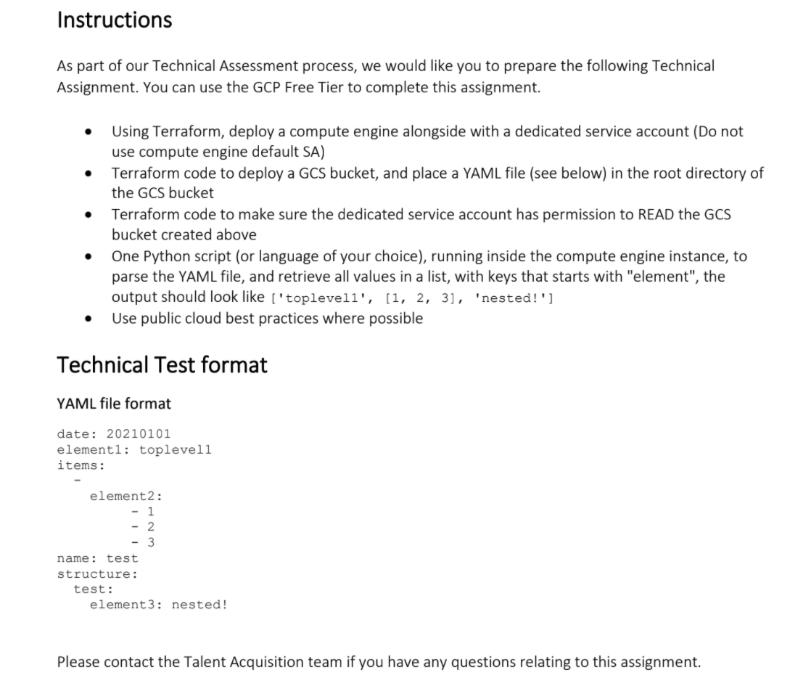
Technical Assignment Instructions
Notes:
Open source mean ; Community driven
No need to be a coder, no need to change carrier to become programmer
Cloud formation can only used in AWS, deployment only used in GCP etc
Next slide, lets discuss about current IT legacy process and deployment models

Slide 40
Understanding the Requirements
We need Terraform script to provision following services
Compute Engine with custom service account.
Service account with appropriate policy and IAM roles.
Provisioning GCS Bucket with Read Access and upload YAML file.
Cloud NAT implementation required for VM host.
Create custom roles with least privilege in mind .
Python script to parse YAML file.
Other assumptions: Custom VPC, Firewall rules, Service account with OAuth2 tokens for authentication with Cloud API, Not allocating public IP address on host
Notes:
Open source mean ; Community driven
No need to be a coder, no need to change carrier to become programmer
Cloud formation can only used in AWS, deployment only used in GCP etc
Next slide, lets discuss about current IT legacy process and deployment models

Slide 41
Understanding the Requirements
We need Terraform script to provision following services
Compute Engine with custom service account.
Service account with appropriate policy and IAM roles.
Provisioning GCS Bucket with Read Access and upload YAML file.
Cloud NAT implementation required for VM host.
Create custom roles with least privilege in mind .
Python script to parse YAML file.
Other assumptions: Custom VPC, Firewall rules, Service account with OAuth2 tokens for authentication with Cloud API, Not allocating public IP address on host
Notes:
Open source mean ; Community driven
No need to be a coder, no need to change carrier to become programmer
Cloud formation can only used in AWS, deployment only used in GCP etc
Next slide, lets discuss about current IT legacy process and deployment models

Slide 42
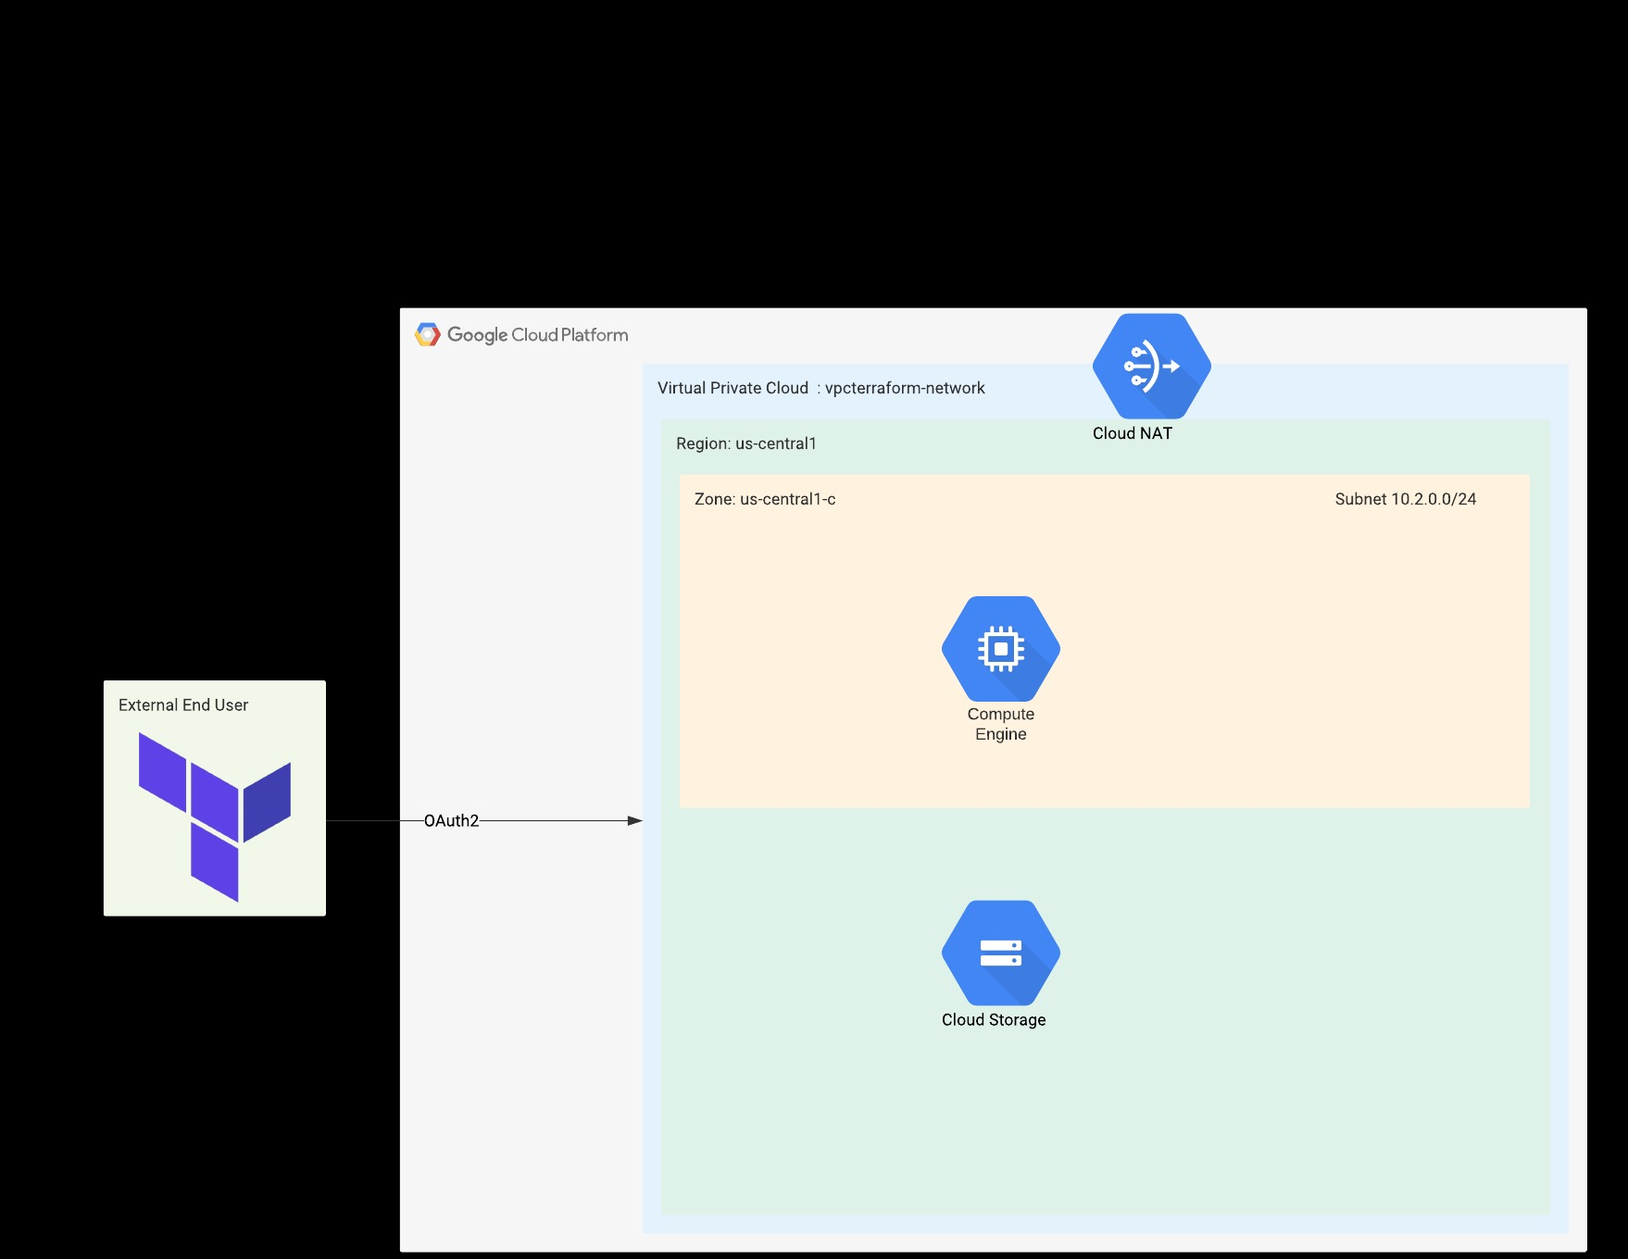
Diagram
Notes:
Save us lot of headache
No need of domain knowledge
Traditional infrastructure no sort of auto scaling concepts
Cloud is different - add more resource of same type
- Idempotent compares the real world desired end state to decide what to add, delete or upgrade without having to
Reprovision the whole infrastructure
- immutable
Reduce configuration drift/bad changes
Easier to updgaer / rolls back

Slide 43
IaaC Components
01
05
02
06
03
07
04
08
VPC Network
Firewall
Custom mode VPC
Custom Firewall rules
Service Account
VM instance & Subnetwork
Compute Engine custom service account
Linux box provisioned in custom IP CIDR range
GCS Bucket
Cloud NAT/Router
Root folder with yaml file
VM to download packages
IAM Policy and Bindings
Demo
Creating a Custom roles for GCE Service account
Will see Terraform in action
Notes:
Lets jump into this and talk about
What we going to discuss in this video
Initially we start with basic of Terraform
What are the process and deployment models we use in legacy environment, this will be a fun topic to be discussed
Than going forward we will see Benefits of using terraform
IN the end we are going to see the demo

Slide 44
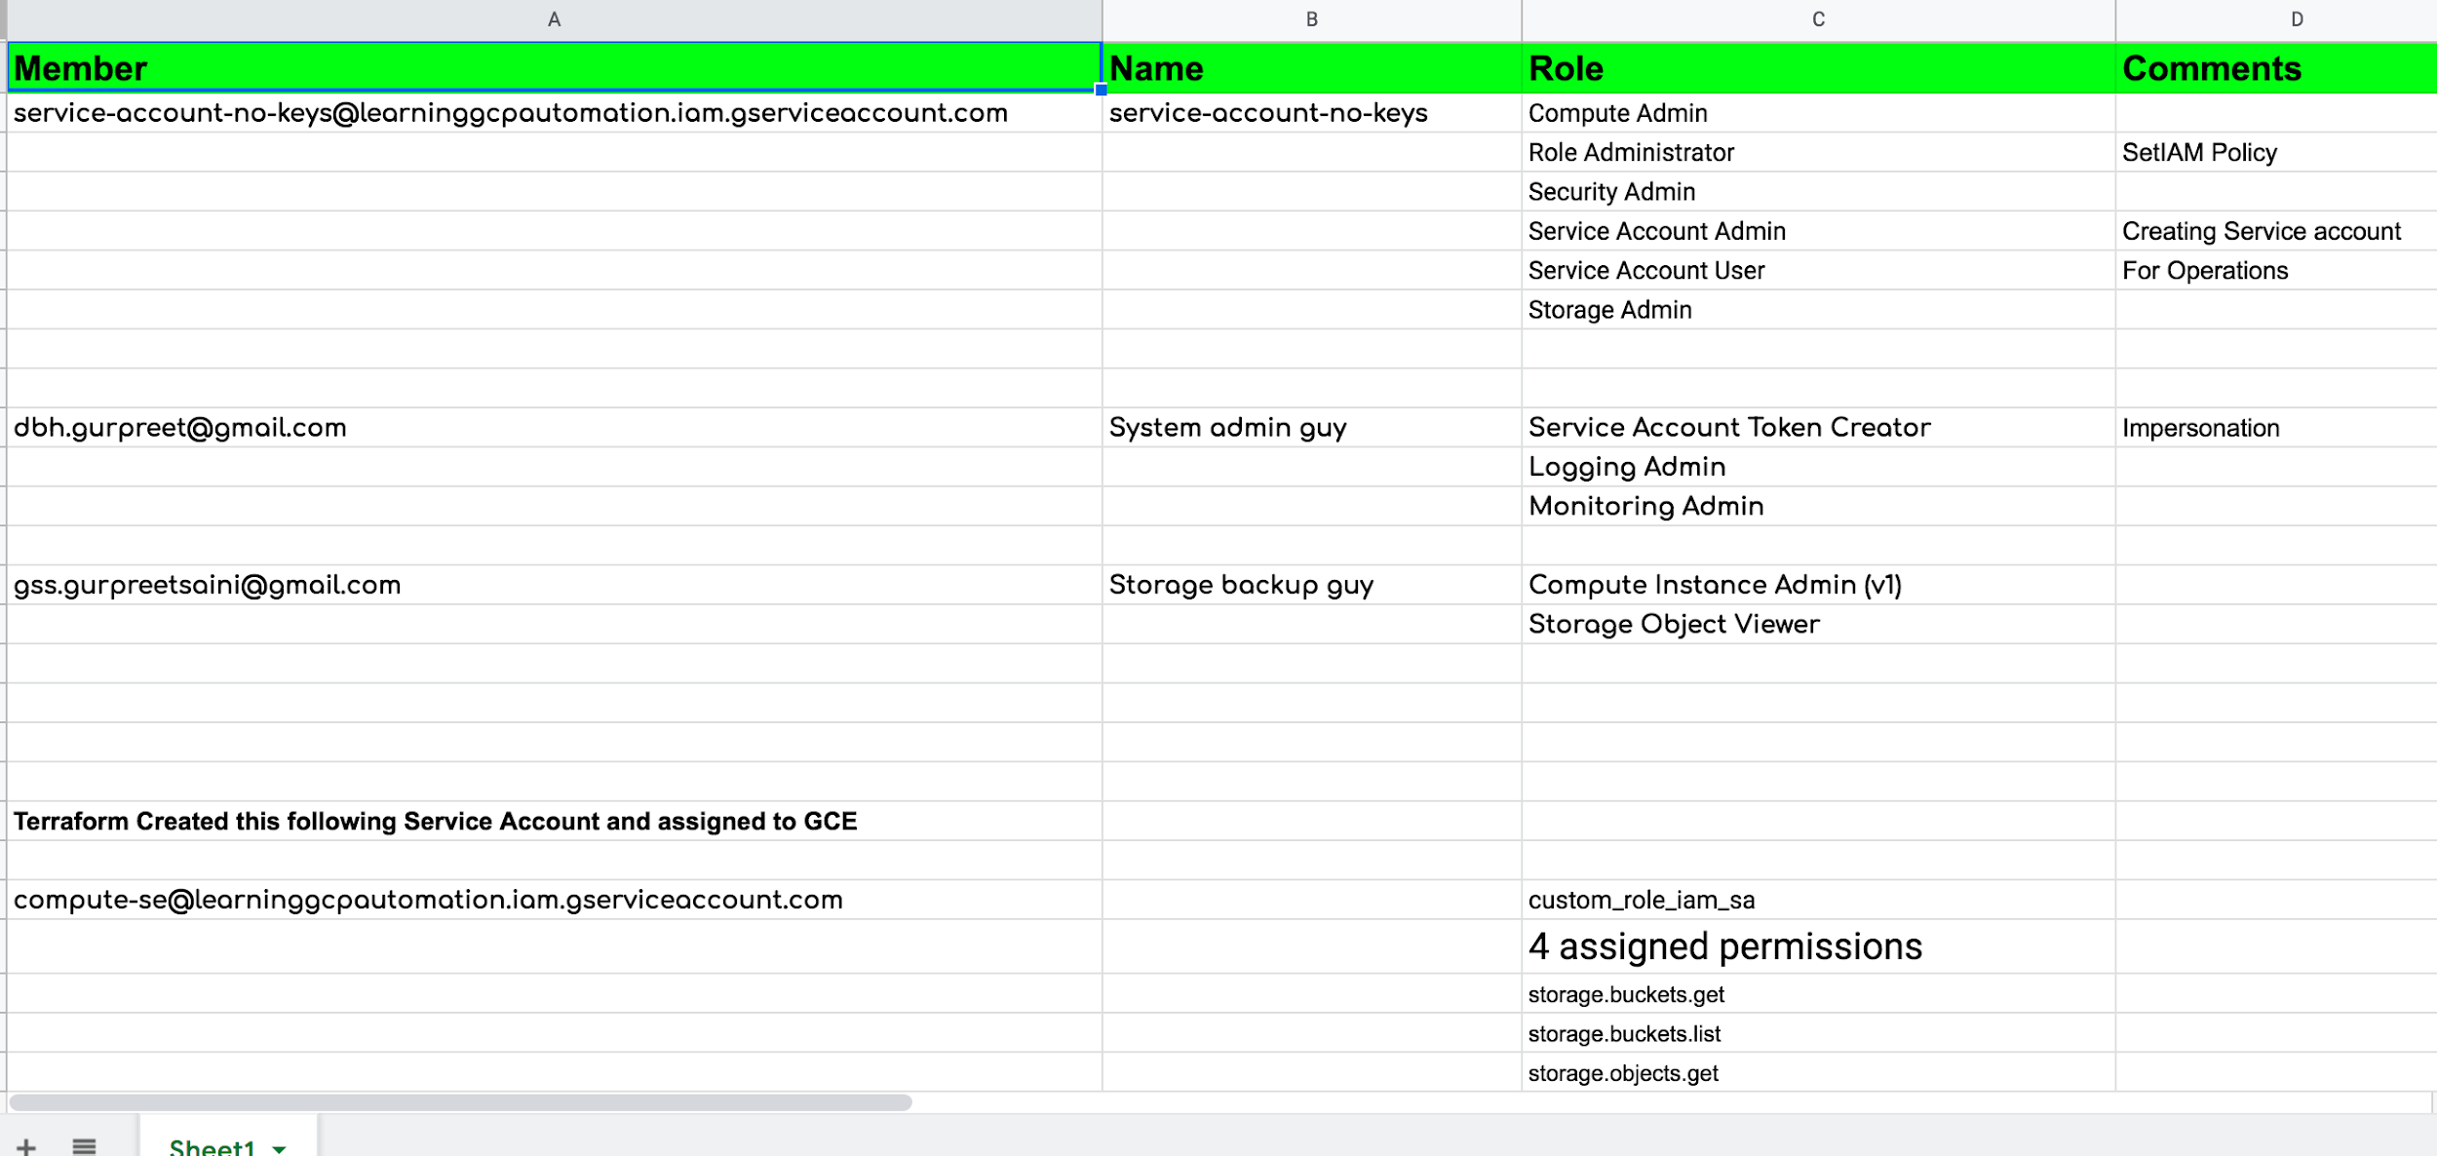
IAM Members
provider "velocloud" {
version = "~> 1.0"
...
}

Slide 45
04
What are Providers ?
Notes:
Hello and welcome to my youtube channel, My name is Gurpreet
In this video series, I am gonna talk about Automate GCP with Terraform
I will be happy to share my knowledge and experience related to Terraform with examples and demos in this video series

Slide 46
Important points to remember for provider
We have official providers and non official, official provider is managed by HashiCorp
Two ways to download providers
Automatic (using terraform init )
Manually
Install required Go version
Need to read provider Github documentation
Prefer official plugins for provider over non official plugins
https://registry.terraform.io/ -> Public registry to find provider (Official/non Official)
Notes:
Open source mean ; Community driven
No need to be a coder, no need to change carrier to become programmer
Cloud formation can only used in AWS, deployment only used in GCP etc
Next slide, lets discuss about current IT legacy process and deployment models

Slide 47
Terraform init
Installing provider manually
Test your configuration
Init
Working directory
Manually install
Write configuration file
Test
Current working directory get provider downloaded (Automatically)
You will write configuration file

Slide 48
05
Terraform Core
Notes:
Hello and welcome to my youtube channel, My name is Gurpreet
In this video series, I am gonna talk about Automate GCP with Terraform
I will be happy to share my knowledge and experience related to Terraform with examples and demos in this video series

Slide 49
Terraform Core
Terraform Core is a compiled binary. Source code is available on Github
Written in Go language, easy to portable on various OS
Primary responsibility of Terraform Core
HCL language support (reading, writing, interpolation of config files)
Visualization of Terraform deployment as Graph
Communication with plugins and Various providers
Terraform workflow : init, plan and deploy
State management
Local
Remote
Notes:
Open source mean ; Community driven
No need to be a coder, no need to change carrier to become programmer
Cloud formation can only used in AWS, deployment only used in GCP etc
Next slide, lets discuss about current IT legacy process and deployment models

Slide 50
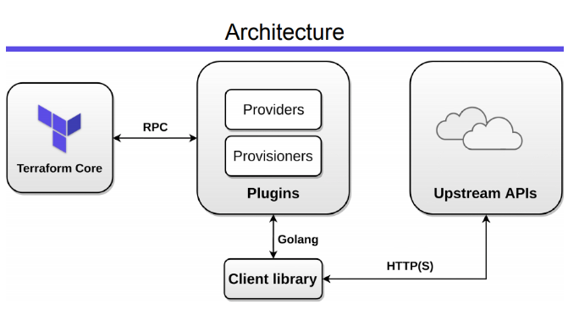
Overview
https://events19.linuxfoundation.org/wp-content/uploads/2017/12/Hashicorp-Terraform-Deep-Dive-with-no-Fear-Victor-Turbinsky-Texuna.pdf
Notes:
Save us lot of headache
No need of domain knowledge
Traditional infrastructure no sort of auto scaling concepts
Cloud is different - add more resource of same type
- Idempotent compares the real world desired end state to decide what to add, delete or upgrade without having to
Reprovision the whole infrastructure
- immutable
Reduce configuration drift/bad changes
Easier to updgaer / rolls back

Slide 51
06
Terraform Core features
Notes:
Hello and welcome to my youtube channel, My name is Gurpreet
In this video series, I am gonna talk about Automate GCP with Terraform
I will be happy to share my knowledge and experience related to Terraform with examples and demos in this video series

Slide 52
06
Terraform Core features
Notes:
Hello and welcome to my youtube channel, My name is Gurpreet
In this video series, I am gonna talk about Automate GCP with Terraform
I will be happy to share my knowledge and experience related to Terraform with examples and demos in this video series

